Slide 1
Digital Portfolio
STUDENT NAME: SABARNA S
REGISTER NO AND NMID: 2422k0220 & 1EE97A2D79E3342A4494D47EEB77824E
DEPARTMENT: COMPUTER SCIENCE
COLLEGE: SRI VASAVI COLLEGE / BHARATHIYAR UNIVERSITY

Slide 2
PROJECT TITLE
STUDENT PORTFOLIO

Slide 3


AGENDA
Problem Statement
Project Overview
End Users
Tools and Technologies
Portfolio design and Layout
Features and Functionality
Results and Screenshots
Conclusion
Github Link
3/21/2024 Annual Review

Slide 4

PROBLEM STATEMENT
"Design a system to effectively manage and showcase student portfolios, enabling students to demonstrate their skills and progress, while providing educators with a comprehensive view of student performance and areas for improvement."

Slide 5

PROJECT OVERVIEW
The Student Portfolio project aims to develop a digital platform where students can create, manage, and showcase their work, enabling them to demonstrate their skills, progress, and achievements. The platform will provide a user-friendly interface for students to upload projects, assignments, and achievements, while educators can track student progress, provide feedback, and assess their work.

Slide 6

WHO ARE THE END USERS?
Students: They will create, manage, and showcase their portfolios, uploading projects, assignments, and achievements. 2. Educators: Teachers, instructors, and mentors will track student progress, provide feedback, and assess their work. These two groups will primarily interact with the platform, leveraging its features to enhance learning, teaching, and assessment.

Slide 7

TOOLS AND TECHNIQUES
We're using HTML, CSS, and JavaScript which are like the building blocks for making websites. HTML is for structure. CSS makes it look good. and JavaScript makes it interactive.

Slide 8
PORTFOLIO DESIGN AND LAYOUT
Design: 1. Choose a color scheme and typography 2. Use high-quality images and whitespace Layout: 1. Header with name and navigation 2. Hero section with featured project 3. Project grid with descriptions 4. About section with bio and interests 5. Contact/footer with contact info
8

Slide 9
FEATURES AND FUNCTIONALITY
Portfolio features and functionality include management tools for organizing assets or projects, risk and resource management, performance analysis and reporting, and strategic alignment through prioritization and resource allocation. Functionality also enables asset diversification, tracking costs and benefits, managing dependencies, and improving strategic decision-making across various organizational levels.

Slide 10
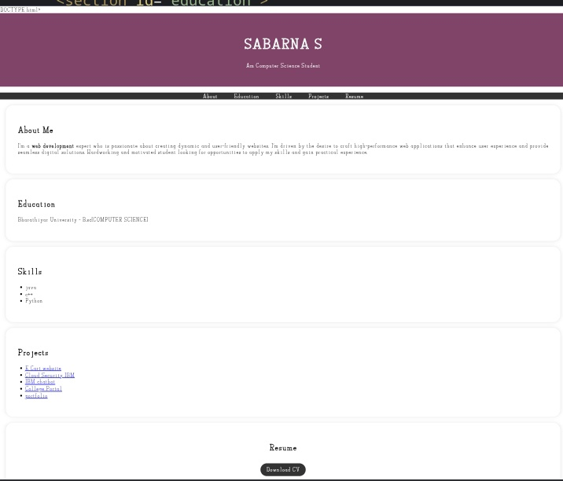

RESULTS AND SCREENSHOTS
3/21/2024 Annual Review
10

Slide 11
CONCLUSION
A well-designed student portfolio is an essential tool for showcasing skills, achievements, and experiences. By incorporating key features and functionality, students can create a comprehensive and effective portfolio that highlights their strengths and accomplishments. Whether digital or physical. a student portfolio is a valuable resource for academic, professional, or personal development
11

